Slide 1
Hadoop (An Ecosystem for Big Data)

Slide 2
Hadoop (An Ecosystem for Big Data)
Its is an Ecosystem which provides foundation to the many open source projects and Application
Features:
Highly Scalable - scale hundreds of nodes in a single cluster.
Replication - Due to some unfavorable conditions, the node containing the data may be loss. So, to overcome.
Fault tolerance - In HDFS, the fault tolerance signifies the robustness of the system in the event of failure.
Distributed data storage-. Here, data is divided into multiple blocks and stored into nodes.
Portable- HDFS is designed in such a way that it can easily portable from platform to another.

Slide 3
Hadoop (An Ecosystem for Big Data)
Goals of HDFS
Handling the hardware failure -The HDFS contains multiple server machines. Anyhow, if any machine fails, the HDFS goal is to recover it quickly.
Streaming data access - The HDFS applications usually run on the general-purpose file system. This application requires streaming access to their data sets.
Coherence Model -The application that runs on HDFS require to follow the write-once-ready-many approach. So, once created need not to be changed. However, it can be appended and truncate
Optimized for a Variety of Data Types
Hadoop comes with a distributed file system called HDFS
In HDFS data is distributed over several machines an replicated to ensure their durability to failure and high availability to parallel application.
'A-. It is cost effective as it uses commodity hardware.
'A- It involves the concept of blocks, data nodes and node name.

Slide 4
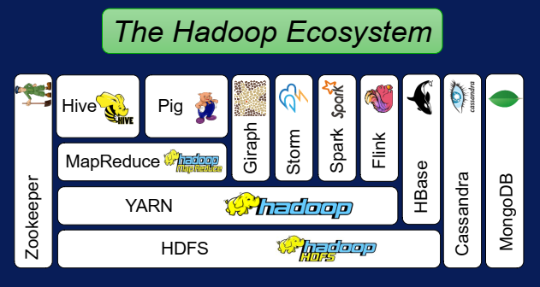
Hadoop Ecosystem

Slide 5
Origin of Hadoop (Big data open-source movemen)
In 2004 Google published a paper about their in-house processing framework they called MapReduce.
The next year, Yahoo released an open-source implementation based on this framework called Hadoop.
In the following years, other frameworks and tools were released to the community as open-source projects. These frameworks provided new capabilities missing in Hadoop, such as SQL like querying or high level scripting. Now, there are over 100 open-source projects for big data and this number continues to grow. Many rely on Hadoop, but some are independent.

Slide 6

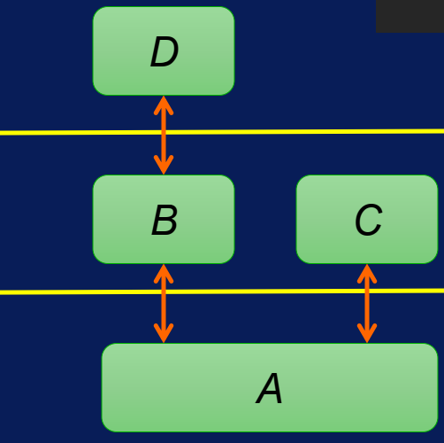

Layered Diagram of Hadoop Eco System
Hadoop Ecosystem works in layers with following functionalities:
In a layer diagram, a component uses the functionality or capabilities of the components in the layer below it.
Usually components at the same layer do not communicate. And a component never assumes a specific tool or component is above it.
In this example, component A is in the bottom layer, which components B and C use.
Component D uses B, but not C.
D does not directly use A.

Slide 7
Features of Hadoop
DFS (Distributed File System) at the foundation provides salable storage and fault tolerance.
YARN provides Flexible scheduling and resource management which schedules jobs on > 40,000 servers at Yahoo
Simplified programming model Map -> apply(), Reduce ->summarize()
Higher-level programming models Pig = dataflow scripting (Data flow script (DFS) is the underlying metadata, similar to a coding language, that is used to execute the transformations that are included in a mapping data flow.) Hive = SQL-like queries Specialized models for graph processing. Giraph used by Facebook to analyze social graphs NoSQL projects such as Cassandra, MongoDB, and HBase
Similarly, Storm, Spark, and Flink were built for real time and in memory processing of big data on top of the YARN resource scheduler and HDFS
Finally, running all of these tools requires a centralized management system for synchronization, configuration and to ensure high availability.
Zookeeper performs these duties.

Slide 8
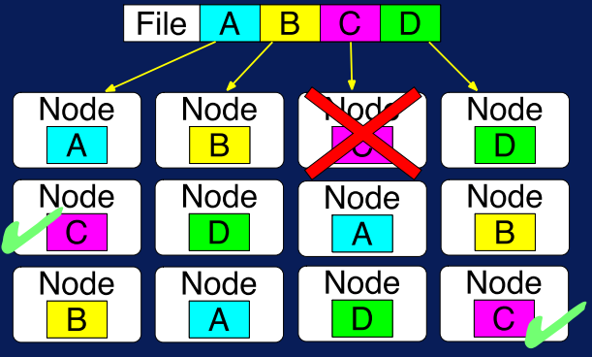
HDFS
It store massively large data sets up to 200 Petabytes, 4500 servers, 1 billion files and blocks
HDFS splits files across nodes for parallel access
Replication for fault tolerance
Customized reading to handle variety of file types such as text, images, geo spatial data, other domain specific data formats.
Like FASTA, or FASTQ formats for sequence data genomics.

Slide 9
HDFS
Two key components of HDFS 1. NameNode for metadata
Usually one per cluster 2. DataNode for block storage Usually one per machine
The NameNode coordinates operations Keeps track of file name, location in directory, etc. Mapping of contents on DataNode.
DataNode stores file blocks Listens to NameNode for block creation, deletion, replication

Slide 10
HDFS
Block is the minimum amount of data that it can read or write. HDFS blocks are 128 MB by default and this is configurable. Files in HDFS are broken into block-sized chunks , which are stored as independent units.
Name Node: HDFS works in master-worker pattern where the name node acts as master. Name Node is controller and manager of HDFS as it knows the status and the metadata of all the files in HDFS; the metadata information being file permission, names and location of each block.
Data Node: They store and retrieve blocks when they are told to; by client or name node. They report back to name node periodically, with list of blocks that they are storing. The data node being a commodity hardware also does the work of block creation, deletion and replication as stated by the name node.

Slide 11
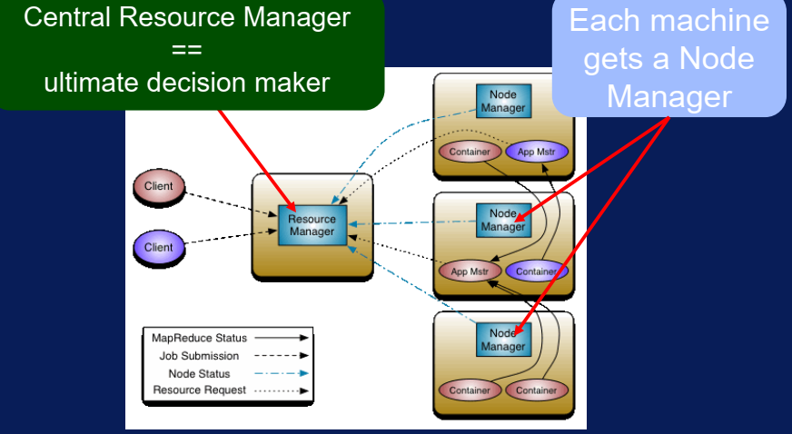
YARN
YARN, The Resource Manager for Hadoop which sits above the HDFS.
YARN enables running multiple applications over HDFS increases resource efficiency

Slide 12
YARN
The resource manager controls all the resources, and decides who gets what.
Node manager operates at machine level and is in charge of a single machine. Node manager operates at machine level and is in charge of a single machine.
Each application gets an application master. It negotiates resource from the Resource Manager and it talks to Node Manager to get its tasks completed.
The container is an abstract Notions that signifies a resource that is a collection of CPU, memory, disk network and other resources within the compute note

Slide 13
Map Reduce
MapReduce is a programming model for the Hadoop ecosystem. It relies on YARN to schedule and execute parallel processing over the distributed file blocks in HDFS.
Traditional parallel programming requires expertise on a number of computing and systems concepts. For example, synchronization mechanisms like locks, semaphores, and monitors are essential.
The MapReduce programming model greatly simplifies running code in parallel since you don't have to deal with any of these issues. Instead, you only need to create and map and reduce tasks.
Just provide a function, or operation for a map, and reduce. For map, the operation is applied on each data element. And in reduce, the operation summarizes elements in some manner.

Slide 14
Steps of Map Reduce
The MapReduce is a paradigm which has two phases, the mapper phase, and the reducer phase. In the Mapper, the input is given in the form of a key-value pair.
The output of the Mapper is fed to the reducer as input. The reducer runs only after the Mapper is over. The reducer too takes input in key-value format, and the output of reducer is the final output.
Steps in Map Reduce
The map takes data in the form of pairs and returns a list of <key, value> pairs. The keys will not be unique in this case.
Using the output of Map, sort and shuffle are applied by the Hadoop architecture. This sort and shuffle acts on these list of <key, value> pairs and sends out unique keys and a list of values associated with this unique key <key, list(values)>.
An output of sort and shuffle sent to the reducer phase. The reducer performs a defined function on a list of values for unique keys, and Final output <key, value> will be stored/displayed.

Slide 15
Steps of Map Reduce
Sort and Shuffle
The sort and shuffle occur on the output of Mapper and before the reducer. When the Mapper task is complete, the results are sorted by key, partitioned if there are multiple reducers, and then written to disk.
Uses of MapReduce
It can be used in various application like document clustering, distributed sorting, and web link-graph reversal.
It can be used for distributed pattern-based searching.
We can also use MapReduce in machine learning.
It was used by Google to regenerate Google's index of the World Wide Web.
It can be used in multiple computing environments such as multi-cluster, multi-core, and mobile environment.

Slide 16
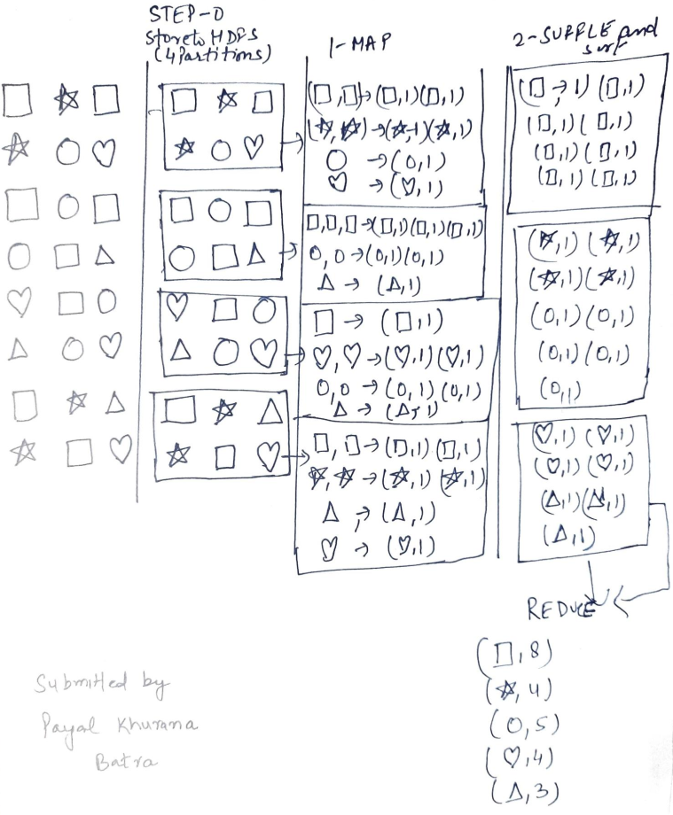
Example Map-Reduce

Slide 17
Usage of HDFS
Where to use HDFS:
Very Large Files: Files should be of hundreds of megabytes, gigabytes or more.
Streaming Data Access: The time to read whole data set is more important than latency in reading the first. HDFS is built on write-once and read-many-times pattern.
Commodity Hardware: It works on low cost hardware
Where not to use HDFS
Low Latency data access: Applications that require very less time to access the first data should not use HDFS as it is giving importance to whole data rather than time to fetch the first record.
Lots Of Small Files: The name node contains the metadata of files in memory and if the files are small in size it takes a lot of memory for name node's memory which is not feasible.
Multiple writes:It should not be used when we have to write multiple times

Slide 18
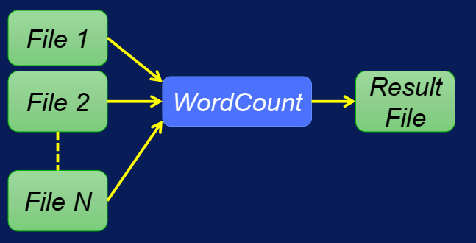
Example: Word Count

Slide 19
References
[1] https://docs.microsoft.com/en-us/azure/architecture/guide/architecture-styles/big-data
[2] https://hadoop.apache.org/docs/r1.2.1/hdfs_design.html
[3] https://www.coursera.org/learn/big-data-introduction/home/week/3

